Slide 1

Decision Table Testing
Testing the Business Logic
Nikolay Nedyalkov
Petar Horozov
Senior QA Engineer
Senior QA Engineer
XAML Team 4
XAML Team 4
Telerik QA Academy

Slide 2

Table of Contents
Decision Table Testing – Main Concepts
Decision Tables
Creating Decision Tables
Collapsing Columns in Decision Tables
Cause-effect Graphs
Decision Table to Cause-effect Graph Transitioning

Slide 3

Table of Contents (2)
Combining Decision Tables With Other Techniques
Avoiding Combinatorial Explosions And Common Errors

Slide 4

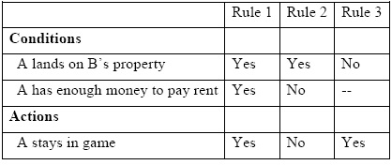
Decision Table Testing – Main Concepts

Slide 5

What is Decision Tables Testing?
Decision tables are a method for testing the business logic that lies underneath the user interface
Decision tables express the rules that govern handling of transactional situations

Slide 6

What is Decision Tables Testing? (2)
Transactional situations
Situations where the conditions that exist at a given moment are sufficient by themselves to determine the actions of the system
Decision tables testing connects combinations of conditions with the actions that should occur

Slide 7
Decision Tables Components
Components
Condition stubs
Interpreted as input
Condition entries
Restricted to binary values (limited entry table)
More than two values (extended entry table)
Action stubs
Interpreted as output
Action entries
Whether an action is to be performed

Slide 8

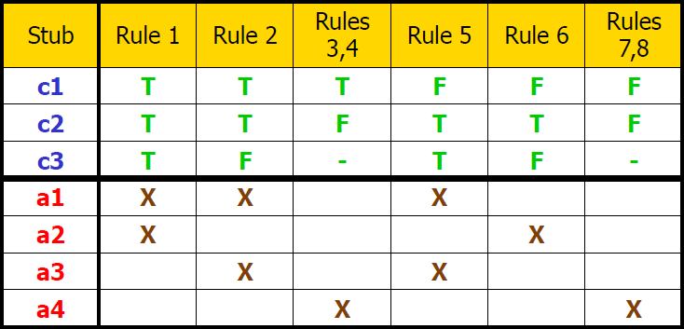
Decision Tables Components (2)
Example of decision table component structure :

Slide 9
The Decision Table Bug Hypothesis
What kind of bugs are we looking for?
Under some combination of conditions, a wrong action might occur
Some action that the system is not to take under this combination of conditions
Under some combination of conditions, the system might not take the right action
Not taking a required action

Slide 10
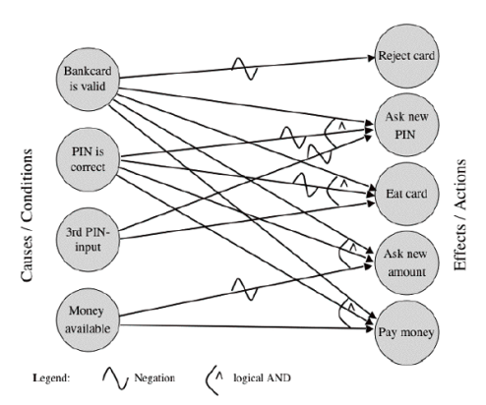
Table vs. Graph
The underlying model of decision table testing has two variations:
Table
More commonly used
Boolean graph
Less typical
If the graph is used, this technique is also referred to as a cause-effect graph

Slide 11

Creating Test Cases
Creating test cases with decision tables
Every rule (column) is replaced with concrete data values
Necessary preconditions are set
During test execution actual actions taken are compared to expected ones

Slide 12
Business Rules
Each column in a decision table contains a business rule
A single business rule
Conditions | 1 | 2 | 3 | 4 | 5 | 6 | 7 | 8
Condition A | Y | Y | Y | Y | N | N | N | N
Condition B | Y | Y | N | N | Y | Y | N | N
Condition C | Y | N | Y | N | Y | N | Y | N
Actions
Action A | Y | Y | N | N | Y | N | N | N
Action B | Y | N | Y | Y | N | Y | N | N

Slide 13

Business Rules (2)
Each business rule says, in essence:
"Under this particular combination of conditions - carry out this particular combination of actions."

Slide 14


The Coverage Criterion
The coverage criterion for decision tables is expressed by a simple rule:
"One test per column in the decision table have to be derived."

Slide 15
Creating a Decision table
The number of columns (business rules) in a decision table is equal to 2^{n}
For n = the number of conditions
Applied when conditions are strictly Boolean – true or false
2^{n} = 8
Conditions | 1 | 2 | 3 | 4 | 5 | 6 | 7 | 8
Condition A | Y | Y | Y | Y | N | N | N | N
Condition B | Y | Y | N | N | Y | Y | N | N
Condition C | Y | N | Y | N | Y | N | Y | N
Actions
…
n = 3

Slide 16
Creating a Decision table (2)
When conditions are not Boolean – extended decision table
Where x = number of possible condition entries
xⁿ = ?
Conditions | 1 | 2 | 3 | 4 | 5 | 6 | 7 | 8
Condition A
Condition B
Condition C
Actions
…
n = 3

Slide 17
Conditions Population Pattern
Conditions in a decision table are populated using a simple pattern:
Half of the first row is filled with "Yes", the other half – with "No"
The second row is filled: first quarter "Yes", second quarter "No" …
…
The last row is filled: one cell "Yes", one cell "No" …

Slide 18
Conditions Population Pattern (2)
Conditions in a decision table are populated using a simple pattern:
Conditions | 1 | 2 | 3 | 4 | 5 | 6 | 7 | 8
Condition A | Y | Y | Y | Y | N | N | N | N
Condition B | Y | Y | N | N | Y | Y | N | N
Condition C | Y | N | Y | N | Y | N | Y | N
Actions
…

Slide 19
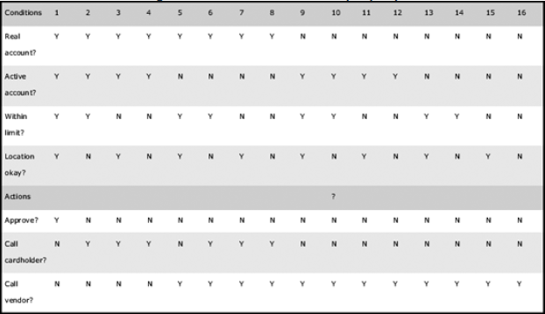
Creating Decision Tables
Demo

Slide 20

Collapsing Columns in Decision Tables
Reducing the Repetitive Test Rules

Slide 21
Collapsing Columns In a Decision Table
Not all columns in a decision table are actually needed
We can sometimes collapse the decision table, combining columns, to achieve a more concise decision table
Performed when the value of one or more particular conditions can't affect the actions for two or more combinations of conditions

Slide 22
Collapsing Columns In a Decision Table (2)
To combine columns – we should look for two or more columns that result in the same combination of actions
Conditions | 1 | 2 | 3 | 4 | 5 | 6 | 7 | 8
Condition A | Y | Y | Y | Y | N | N | N | N
Condition B | Y | Y | N | N | Y | Y | N | N
Condition C | Y | N | Y | N | Y | N | Y | N
Actions
Action A | Y | Y | Y | N | N | N | N | N
Action B | Y | N | Y | Y | Y | Y | N | N
Action C | Y | Y | N | Y | Y | N | N | N

Slide 23
Collapsing Columns In a Decision Table (3)
In these columns – some of the conditions will be the same, and some will be different
Different ones don't seem to affect the outcome
Conditions | 1 | 2 | 3 | 4 | 5 | 6 | 7 | 8
Condition A | Y | Y | Y | Y | N | N | N | N
Condition B | Y | Y | N | N | Y | Y | N | N
Condition C | Y | N | Y | N | Y | N | Y | N
Actions
Action A | Y | Y | Y | N | N | N | N | N
Action B | Y | N | Y | Y | Y | Y | N | N
Action C | Y | Y | N | Y | Y | N | N | N

Slide 24
Collapsing Columns In a Decision Table (4)
Each group of repetitive two (or more) columns can be combined in a single one
4 = 5
7 = 8
Conditions | 1 | 2 | 3 | 4 | 5 | 6 | 7 | 8
Condition A | Y | Y | Y | Y | N | N | N | N
Condition B | Y | Y | N | N | Y | Y | N | N
Condition C | Y | N | Y | N | Y | N | Y | N
Actions
Action A | Y | Y | Y | N | N | N | N | N
Action B | Y | N | Y | Y | Y | Y | N | N
Action C | Y | Y | N | Y | Y | N | N | N

Slide 25
Collapsing Columns In a Decision Table (5)
Insignificant values are replaced with "–" (dash)
Means that any value can be used
Conditions | 1 | 2 | 3 | 4 | 5 | 6
Condition A | Y | Y | Y | – | N | N
Condition B | Y | Y | N | N | Y | N
Condition C | Y | N | Y | N | N | –
Actions
Action A | Y | Y | Y | N | N | N
Action B | Y | N | Y | Y | Y | N
Action C | Y | Y | N | Y | N | N

Slide 26

A Little Hint
Combinable columns are often next to each other
Nevertheless this is not always the case

Slide 27
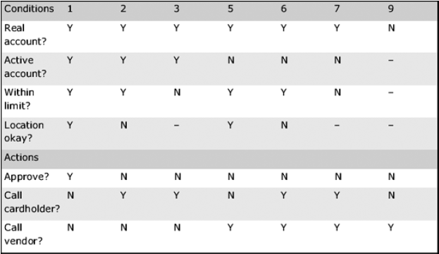
Collapsing Columns in a Decision Table
Demo

Slide 28

Transitions Between Decision Tables and Cause-effect Graphs

Slide 29
Cause-effect Graphs
Cause-effect graphs are graphical representations of the same rules, described via decision tables
They can be very helpful for assuring no mistakes are made in cases of collapsing decision tables
Cause-effect graphs can be converted from decision tables or created directly

Slide 30
Table to Graph Transitioning
Creating a cause-effect graph from a decision table can be performed in a few steps:
List all the conditions on left of the blank page
List all the actions on the right of the page
Read the table to identify how combinations cause an action
Connect one or more conditions with each action using Boolean operators
Repeat for all actions

Slide 31




Cause-effect Graphs Legend
Interactions in cause-effect graphs are represented with Boolean operations according to the following legend:
A causes B
Not A causes B
A1 or A2 causes B
A1 and A2 causes B

Slide 32
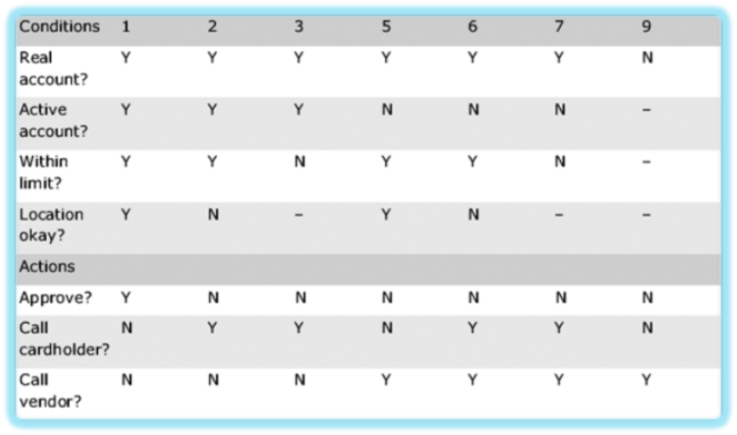
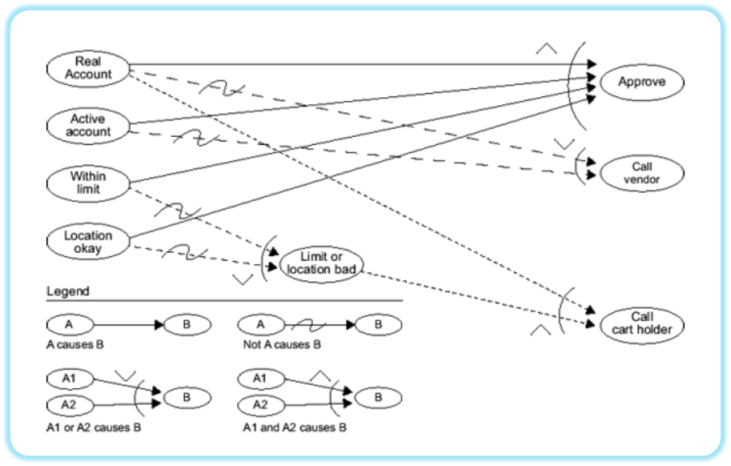
Decision Table to Cause-effect Graph Transitioning
Demo

Slide 33
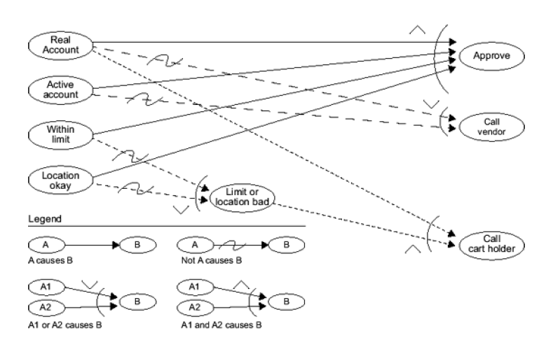
Cause-effect Graphs

Slide 34
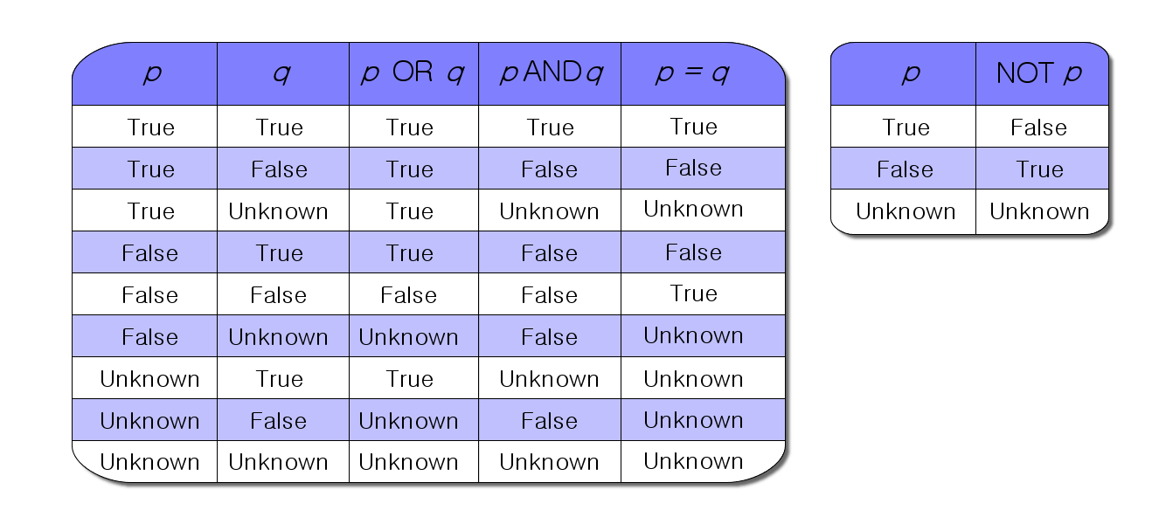
Truth Tables
For fulfilling the coverage criterion for cause-effect graphs a "truth table" is generated
Contains all possible combinations of conditions
Serves for ensuring that one test for each row of the truth table is generated

Slide 35

Combining Decision Tables With Other Techniques

Slide 36


Nonexclusive Rules in Decision Tables Testing

Slide 37
Nonexclusive Rules
Sometimes more than one rule can apply to a transaction
Zero, one, several or all of the rules may be applied at the same time
Conditions | 1 | 2 | 3
Red | Y | - | -
Yellow | - | Y | -
Green | - | - | Y
Actions
Stop | Y | - | -
Ready | - | Y | -
Go | - | - | Y

Slide 38

Avoiding Combinatorial Explosions And Common Errors

Slide 39
Avoiding Combinatorial Explosions
"Combinatorial explosions"
Testing combinations of factors without consideration of the total count of those tests
Consider the amount of combinations before trying to test them all
How many combination exist for testing 3 factors with 2 options each?
What about 6 factors with 5 options each?
2³ = 8
5⁶ = 15 625

Slide 40

Avoiding Combinatorial Explosions (2)
Combinatorial explosions can be avoided:
Identify the possible combinations
Use risk to weight those combinations
Test only the important combinations
Other techniques are also applicable:
Classification trees
Pairwise testing

Slide 41
Common Errors
Incompleteness
Not all conditions are covered
Contradiction
Two rules with the same conditions lead to different actions
Redundancy
Two rules with the same conditions lead to the same action
Ambiguity
A reduced table with contradictory and/or redundancy errors

Slide 42
Decision Table Testing
?
?
?
?
?
Questions?
?
?
?
?
?
?

Slide 43
Exercises (1)
Below is a decision table for reservation of meeting room. Fill in the columns with true and false:
Conditions | 1 | 2 | 3 | 4 | 5 | 6 | 7 | 8
No. of participants <= capacity?
Room available?
Account no. valid?
Actions
Msg: No room of the right size available
Msg: Room already booked
Msg: Account no. not valid
Book room

Slide 44
Exercises (2)
Below is a decision table for daily activities. Fill in the columns with true and false:
Conditions | 1 | 2 | 3 | 4 | 5 | 6 | 7 | 8
Is today a weekday?
Is today a holiday?
Is it raining?
Actions
Go to work
Go on a picnic
Stay home

Slide 45
Exercises (3)
A store wishes to program a decision on non-cash receipts for goods into their intelligent tills.
The conditions to check are agreed as:
Transaction under £50
Pays by cheque with cheque card (guarantee £50)
Pays by credit card
The possible actions that a cashier could take are agreed as:

Slide 46
Exercises (3)
Ring up sale
Call a supervisor
Automatic check of credit card company database
Using the rules above construct a decision table showing all possible combinations of alternatives.

Slide 47
Resources
http://decisiontables.wikispaces.com/Types+of+Decision+Tables
http://www.cems.uwe.ac.uk/jharney/table.html
http://books.google.bg/books?id=yU-rTcurys8C&pg=PA133&dq=cause+effect+graphs&hl=en&sa=X&ei=PVPEUbC2HY7dsgaj14E4&ved=0CDgQ6AEwAg#v=onepage&q=cause%20effect%20graphs&f=false

Slide 48
Contacts
Nikolay Nedyalkov
email: nikolay.nedyalkov@telerik.com
Petar Horozov
email: petar.horozov@telerik.com

